Slide 1
Starter
Write and answer the following questions:
List as many different types of jobs that involve rocks? List at least 5.
5/ 2 /2020

Slide 2
Describe the structure of the Earth
TRACK WITH ME
READ WITH ME
Draw and label the different layers of the Earth
Describe the role of each layer

Slide 3
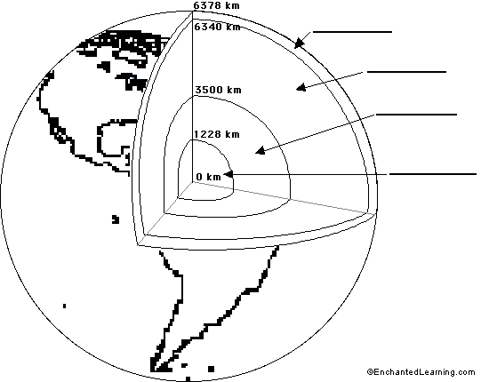

Describe the structure of the Earth
Copy this diagram of the earth onto your book.
You have three minutes

Slide 4
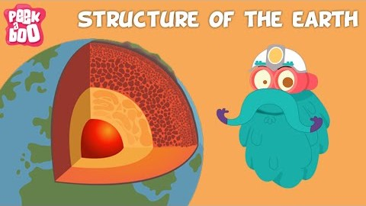
Describe the structure of the Earth
Use the following video to label each layer of the Earth
Notes:
Earth Structure activity
1. Have the student that drew inner core stand in the center and flex his or her muscles (this represents the inner core which is dense and solid metal). 2. Have the students that drew outer core form a circle around the inner core. They should face the center and walk anti-clockwise around the inner core while moving their arms up and down. (this represents the fact that the outer core is liquid and moving. 3. Have the students that drew deep mantle join hands and form a circle around the outer core and chant "hot rock, hot rock". 4. Have the asthensophere students surround the deep mantle. Have them sway back and forth to represent the movement that occurs in this layer. 5. Finally have the lithosphere/crust students form a circle around the entire earth. Have them face outward and slowly walk around the rest of the earth.

Slide 5
Starter
1. Draw and label the structure of the earth.
(Don’t look at your notes book)
2. List four facts about the layers of the earth
5/02/2020

Slide 6
Identify and describe the effects of weathering Define erosion and describe its effect on surfaces
TRACK WITH ME
READ WITH ME
Define the three types of weathering
Classify different weathering examples

